Slide 1
Capstone Engagement
Assessment, Analysis, and Hardening of a Vulnerable System

Slide 2
Table of Contents
This document contains the following sections:
01
Network Topology
02
Red Team: Security Assessment
03
Blue Team: Log Analysis and Attack Characterization
Hardening: Proposed Alarms and Mitigation Strategies
04

Slide 3
Network Topology
3

Slide 4
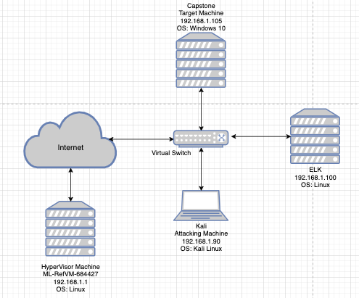
Network Topology
Network
Address Range: 192.168.1.0/24
Netmask: 255.255.255.0
Gateway: 192.168.1.1
Machines
IPv4: 192.168.1.1
OS: Linux
Hostname: ML-RefVM-684427
IPv4:192.168.1.90
OS: Kali Linux
Hostname: Kali
IPv4:192.168.1.100
OS: Linux
Hostname: ELK
IPv4: 192.168.1.105
OS: Windows 10
Hostname: Capstone

Slide 5

Red Team
Security Assessment
5

Slide 6
Recon: Describing the Target
Nmap identified the following hosts on the network:
Hostname | IP Address | Role on Network
ML-RefVm-684427 | 192.168.1.1 | Hypervisoor Host
ELK | 192.168.1.100 | This is the machine that collected the data to be analyzed by the blue team.
Capstone | 192.168.1.105 | This was the target machine that was attacked by the red team and monitored by the blue team
Kali | 192.168.1.90 | This was the attacking machine for the red team.

Slide 7
Vulnerability Assessment
The assessment uncovered the following critical vulnerabilities in the target:
Vulnerability | Description | Impact
Directory Traversal | Directory traversal allows a user to input the file path for directories not on the website. | It allows attacks to get access to web pages that are not supposed to be publicly available.
Open port 22 (SSH) | Port 22 allows a user to open a secure shell into that machine, effectively letting them gain access | If an attacker has the IP address of the machine, they are able to ssh into it and gain access
Weak Hashes | Hashes are assigned to a username and password and are part of the authentication process for granting access to machine | Weak hashes allow an attacker to use a brute force method on the hash algorithm and get access to the account password
exploit/multi/hander listener | This exploit creates a listener on the attacking machine that “listens” for when an uploaded php script is run. | Once the listener detects the php script is running, it grants an attack access to the whole machine

Slide 8
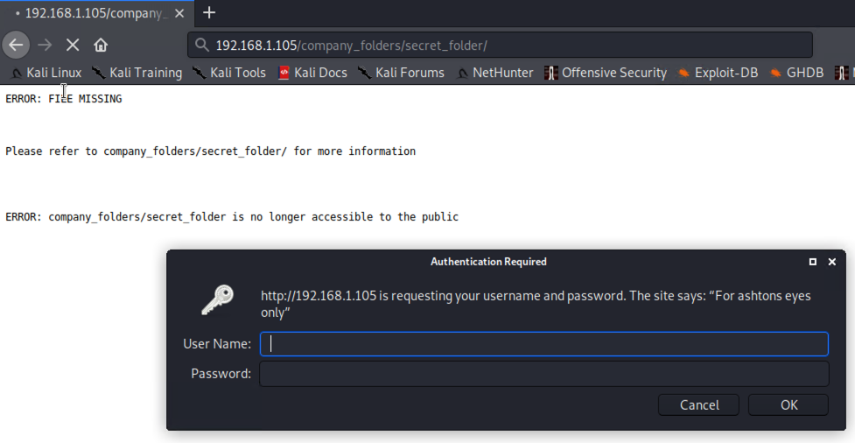
Exploitation: Directory Traversal
01
02
03
Tools & Processes
On the company’s index webpage, we explored some of the files and found the file path to the secret folder was advertised. We simply put the file path in the url and were able to get to the hidden folder.
Achievements
It granted us access to the hidden “secret_folder.” Once we got to the page, we were given a username and password prompt explaining that only ashton had access to that folder. We were able to brute force ashton’s password. This will be discussed below.

Slide 9
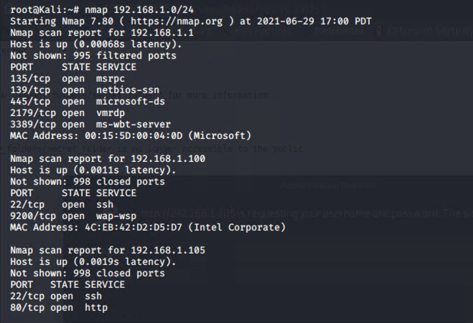
Exploitation: Open Port 22 (SSH)
01
02
03
Tools & Processes
After doing an Nmap scan, we were able to see that port 22 was open. Port 22 can be used to open a secure shell on a machine. We used our virtual machine to ssh into the target machine using the command:
ssh vagrant@192.168.1.105 -p 22
Achievements
This granted us secure shell access to the target machine. This was our first method for gaining full root access to the target machine.

Slide 10
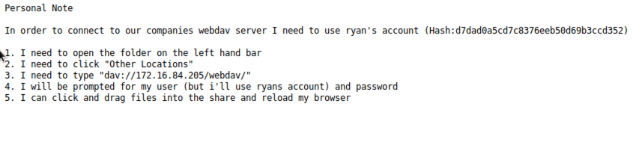
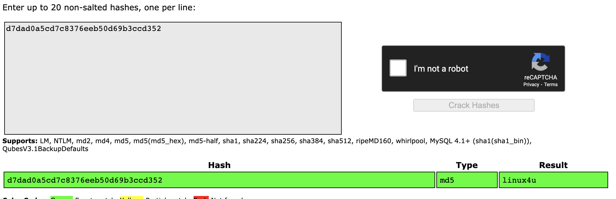
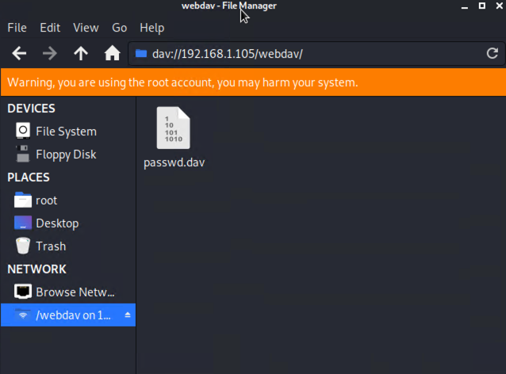
Exploitation: Weak Hashes
01
02
03
Tools & Processes
At two separate points, we were able to exploit the company’s weak hashes. First, we used ashton’s username (ashton) and used the hydra command in linux to crack his password (leopoldo). After that, we were able to crack Ryan’s hash that was listed within the secret folder using the website, Crack Station
Achievements
In both cases, we were able to crack the hashes and get passwords. The first one granted us access to the secret_folder. The second one granted us access to the webdav server.

Slide 11
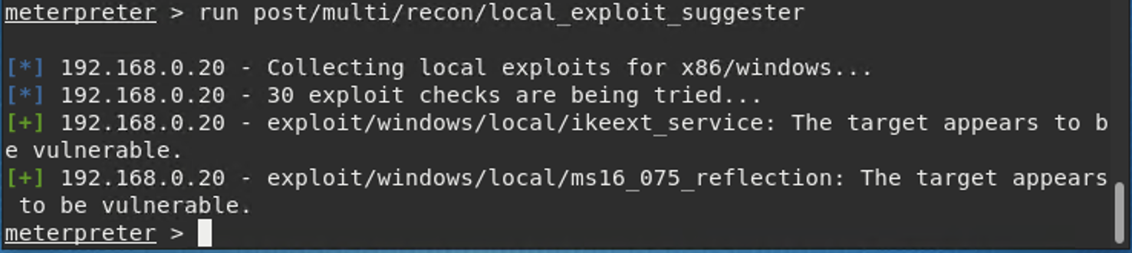
Exploitation: exploit/multi/handler Listener
01
02
03
Tools & Processes
We set up a reverse shell through metasploit. After searching metasploit for which listener we wanted to set up, we chose the exploit/multi/handler because the target machine is running windows. From there we were able to run the php/meterpreter/reverse_tcp payload.
Achievements
The shell ultimately opened a meterpreter session and granted us root access to the target machine after the .php payload file we created was clicked on.

Slide 12

Blue Team
Log Analysis and Attack Characterization
12

Slide 13
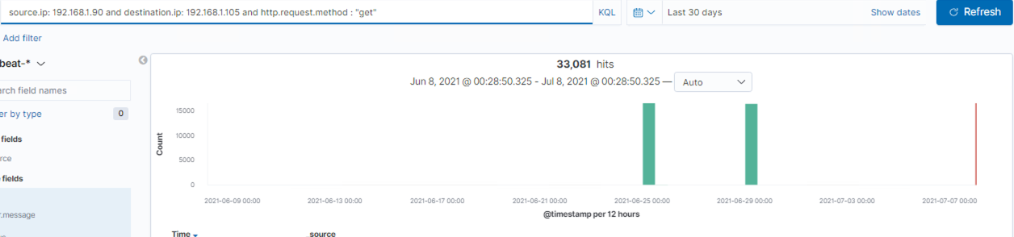
Analysis: Identifying the Port Scan
Notes:
As we can see, the port scan occurred around midnight between June 24 and 25 and then again at midnight between June 29 and 30.
We had 33,081 HTTP GET requests between the two days, all from ip address 192.168.1.90, the attacking machine
We know this was a port scan because
The get requests were sent at this time
Second most network traffic was between the attacking machine and the target server
There was a spike in connections over time

Slide 14

Analysis: Finding the Request for the Hidden Directory
Notes:
the attacker gained access to the machine two separate times and both occurred around midnight
the hidden folder contains Ryan’s account hash which ultimately grants the attacker access to the webdav folder

Slide 15

Analysis: Uncovering the Brute Force Attack
Notes:
between the two times the attacker accessed the system and brute forced Ryan’s hash, there were 32,905 requests made
given that the brute force was run three times for some reason, 32,902 total unsuccessful requests were made

Slide 16


Analysis: Finding the WebDAV Connection
Answer the following questions in bullet points under the screenshot if space allows. Otherwise, add the answers to speaker notes.
How many requests were made to this directory?
Which files were requested?
Notes:
between the two attacking periods, 334 requests were made to the webdav directory
in the webdav directory, the attacker accessed the passwd.dav file
This is also the directory where payload was placed after the attacker gained access

Slide 17
Blue Team
Proposed Alarms and Mitigation Strategies
17

Slide 18
Mitigation: Blocking the Port Scan
What configurations can be set on the host to mitigate port scans?
Set IDS and IPS systems to detect scans
Describe the solution. If possible, provide required command lines.
Programs such as PortSentry and Scanlogd are effective port scan detectors. Scanlogd has no known vulnerabilities, while PortSentry has features that allow the blocking of source IPs of suspected scanners
What kind of alarm can be set to detect future port scans?
An alarm should be created that looks at the number of requested ports for each source ip address.
What threshold would you set to activate this alarm?
This is dependent upon the amount of traffic that occurs on a daily basis. Given the over 33,000 “GET” requests we received in two days, I would recommend a threshold of 10,000.
Notes:
Adding trusted IP addresses to a whitelist can also warn when unauthorized users are sending nmap requests.
https://nmap.org/book/nmap-defenses-detection.html

Slide 19
Mitigation: Finding the Request for the Hidden Directory
What configuration can be set on the host to block unwanted access?
Avoid passing user-supplied input to the filesystem application programming interface.
Describe the solution. If possible, provide required command lines.
Sample Java code to validate the path of a file based on user input:
File file = new File (BASE_DIRECTORY, userInput);
If (file.getCanonicalPath().startsWith(BASE_DIRECTORY)) {//PROCESS FILE
}
What kind of alarm can be set to detect future unauthorized access?
Set an alarm that sends out an alert anytime someone other than Ashton attempts to gain access to the hidden directory.
What threshold would you set to activate this alarm?
The threshold for this alarm should be one. Any IP address not belonging to Ashton should not be allowed to access the secret folder.
Notes:
https://portswigger.net/web-security/file-path-traversal
In addition to the above, another option is to create a whitelist of permitted values that can be inputted

Slide 20
Mitigation: Preventing Brute Force Attacks
What configuration can be set on the host to block brute force attacks?
Multi-factor authentication
Limit the number of failed logins before the account is shut down
Describe the solution. If possible, provide the required command line(s).
Multi-factor authentication ensures that a password alone cannot access an account
Limiting the number of failed logins prevents attackers from constantly trying until they are let in
What kind of alarm can be set to detect future brute force attacks?
An alarm should be set that can detect the number of failed login attempts.
What threshold would you set to activate this alarm?
The threshold should be five failed attempts. If it surpasses five, then shut down authentication fo the user for either a period of time or until security resets the user account.
Notes:
An example of multi-factor authentication requires a code that is sent to the user’s phone. If the code is incorrect, then there is no access.
Another example is the use of a CAPTCHA. It will require the user to pass a test that is easy for humans, but difficult for machines, such as correctly typing out a series of letters or identifying photographs
https://owasp.org/www-community/controls/Blocking_Brute_Force_Attacks

Slide 21
Mitigation: Detecting the WebDAV Connection
What configuration can be set on the host to control access?
Multi-factor authentication
Configure Apache to allow SSL to encrypt data in transfer
Describe the solution. If possible, provide the required command line(s).
On open-source multi-factor authentication program is WiKID Authentication System and uses public key cryptography
Generate SSL keys before editing the httpd.conf file
What kind of alarm can be set to detect future access to this directory?
An alarm should be created that alerts security anytime someone other than Ryan attempts to access the webdav directory.
What threshold would you set to activate this alarm?
There is no threshold. Ryan is supposed to be the only person with access. Anyone else accessing it should activate the alarm.
Notes:
Placing Ryan’s hash out in the open on a file is also liability. It should be much better protected
Salting the hashes can also help. Salting the hashes incorporates random characters into the hash. This is done after the algorithm creates the hash so as to make it more difficult to brute force.
https://www.howtoforge.com/webdav_with_ssl_and_two_factor_authentication

Slide 22
Mitigation: Identifying Reverse Shell Uploads
What kind of alarm can be set to detect future file uploads?
Create an alarm that sends an alert anytime a .php file is uploaded to the file system.
What threshold would you set to activate this alarm?
The threshold is one. Any .php file upload should generate an alarm.
What configuration can be set on the host to block file uploads?
Block execution of file types used in a possible attack, such as .php.
Require authentication to upload files
Describe the solution. If possible, provide the required command line.
If using WordPress, php execution can be blocked. It can be done by following the path below
cPanel>FileManager>uploads>.htaccess
Notes:
Additionally, ports should be consistently monitored to prevent unauthorized access. The reverse shell was uploaded on the computer by gaining access with Ryan’s hash, but the exploit used was came through port 4444.
Make sure to update software when they become available. In addition to sometimes providing new features, updates also patch existing vulnerabilities. The exploit used that ultimately led to an open meterpreter session was allowed to do so because of an unpatched vulnerability on certain Windows operating systems.
https://blog.securityinnovation.com/blog/2014/01/preventing-shell-upload-vulnerabilities-in-php.html
If changing the .htaccess file, input the following code to block php execution:
<Files *.php>
Deny from all
</Files>
https://medium.com/gretathemes/how-to-disable-php-execution-in-the-uploads-folder-in-wordpress-cd34ca2f1dc8

